Slide 1

E-COMMERCE SUPPLY CHAIN ANALYSIS
Presented by: Shubham Upadhyay
PROJECT FILE: E=COMMERCE SUPPLY CHAIN

Slide 2
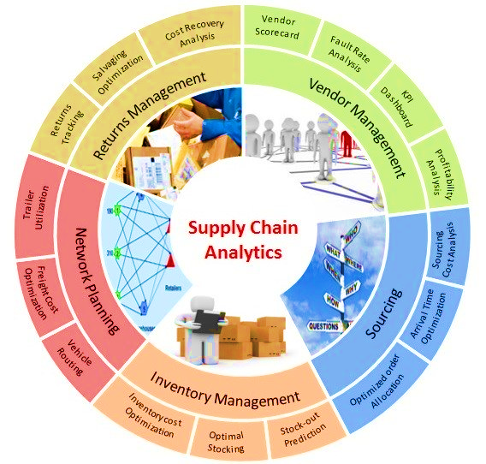
OBJECTIVE
Conduct a comprehensive analysis of the e-commerce supply chain to identify opportunities for enhancing operational efficiency, minimizing costs, and making informed strategic decisions. This analysis should encompass all stages of the supply chain, from procurement and inventory management to order fulfilment and distribution. By understanding the intricacies of the supply chain, businesses can implement targeted improvements that not only streamline processes but also contribute to sustainable growth and long-term success. Additionally, leveraging data analytics and market insights will help inform decisions that align with overall business objectives and enhance customer satisfaction.

Slide 3

KEY CHALLENGES
1. Make a visualization of the price of the products and the revenue generated by them.
2. Analyze the Sales by Product Type.
3. Find out the total revenue generated from shipping carriers.
4. Analyze the revenue generated by each SKU.
5. Analyze the shipping cost of Carriers.
6. Find out the cost distribution by transportation mode.
7. Analyzing the Defect Rate of the product during shipping.

Slide 4
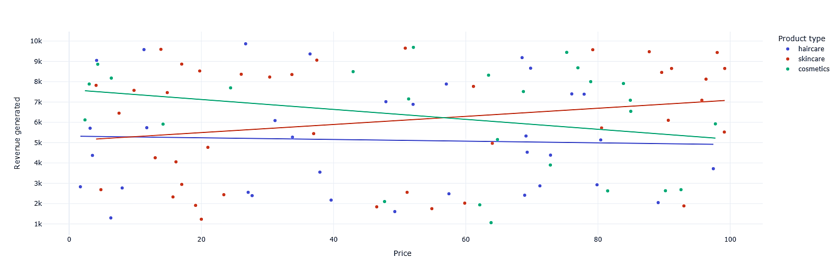
Comparison b/w price of the product and revenue generated with them.
The chart shows that as the price of a product increases, the revenue generated generally increases as well. However, there are fluctuations and the relationship is not perfectly linear. There might be an optimal price point where profit is maximized.

Slide 5

Total sales of the products.
Skincare is the most profitable product for the company, while cosmetics are the least profitable. In conclusion, the company should focus on improving its cosmetic products and marketing them properly.

Slide 6
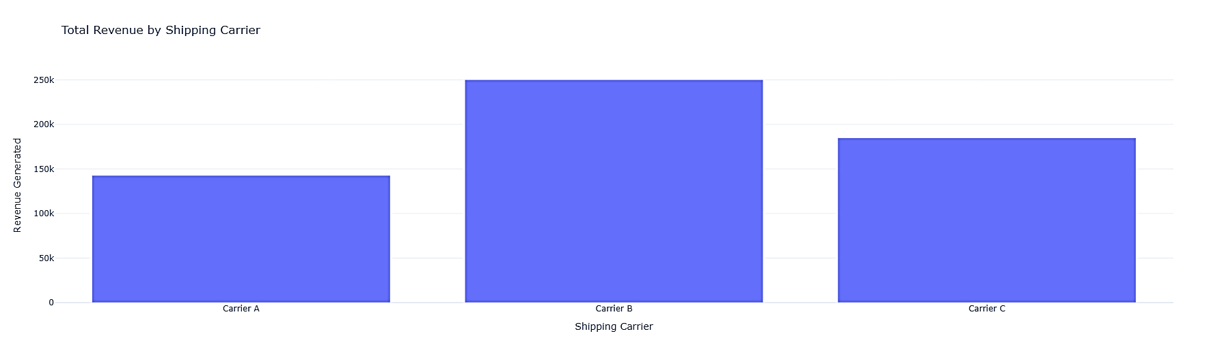
REVENUE COMPARISON OF SHIPPING CARRIERS
This bar chart illustrates the revenue generated by three different shipping carriers (A, B, and C). Carrier B has the highest revenue, followed by Carrier C, and then Carrier A. This visualization helps compare the financial performance of the shipping carriers.

Slide 7
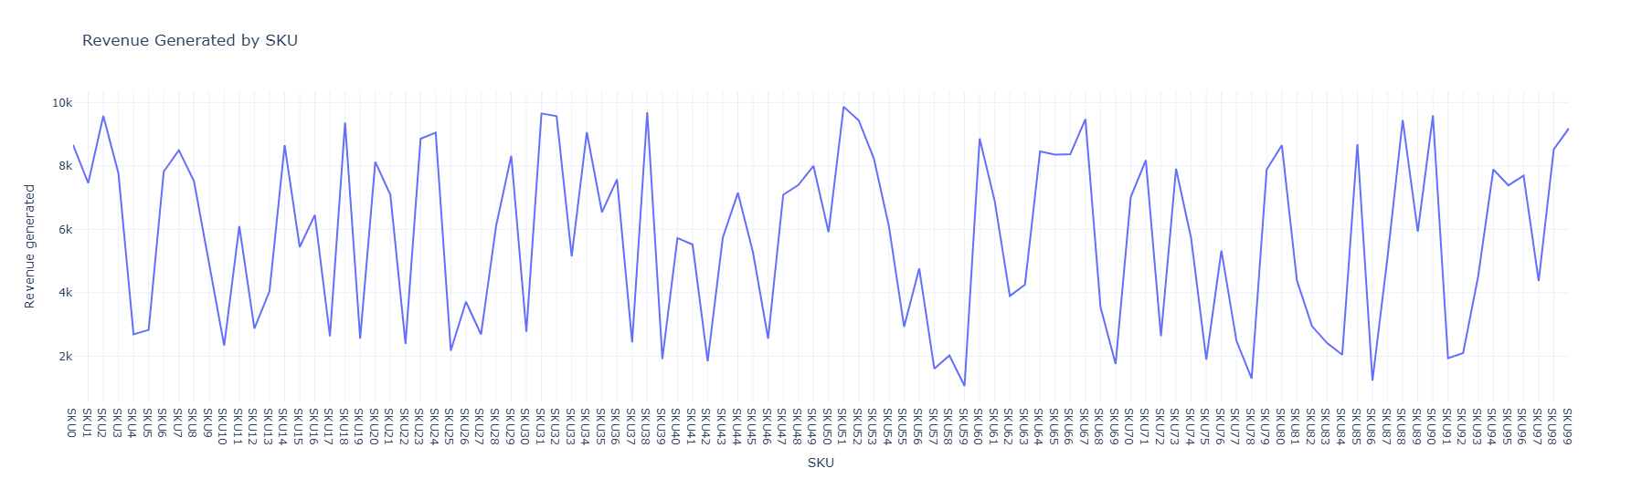
REVENUE PERFORMANCE ACROSS SKUS: TRENDS AND VARIATIONS
The chart displays revenue generated across multiple SKUs (Stock Keeping Units). The revenue fluctuates significantly, with no consistent trend, showing both high peaks and sharp dips across the range of SKUs.

Slide 8
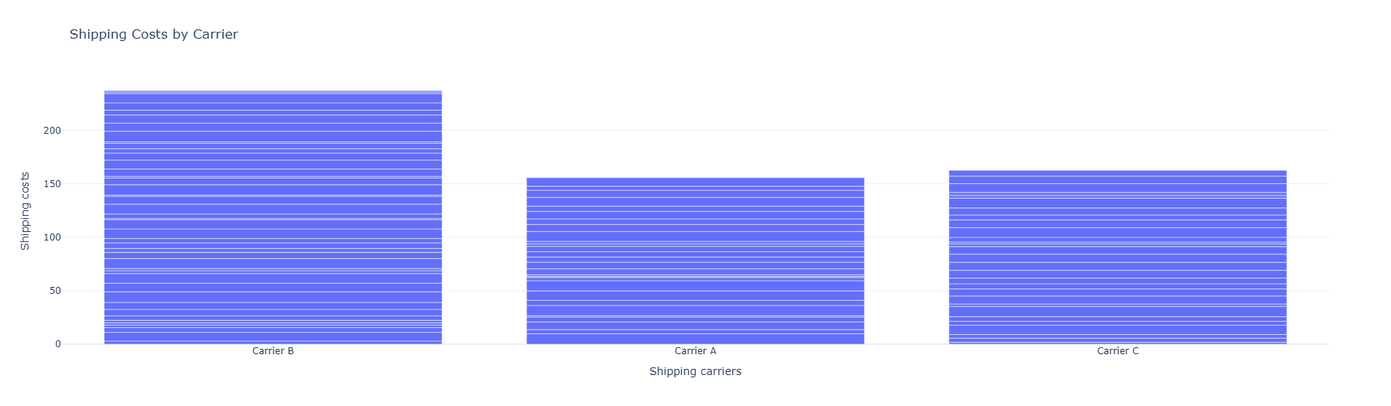
Shipping cost by shipping carrier
This bar chart compares the shipping costs of three carriers (B, A, and C). Carrier B has the highest shipping cost, followed by Carrier C and then Carrier A.

Slide 9
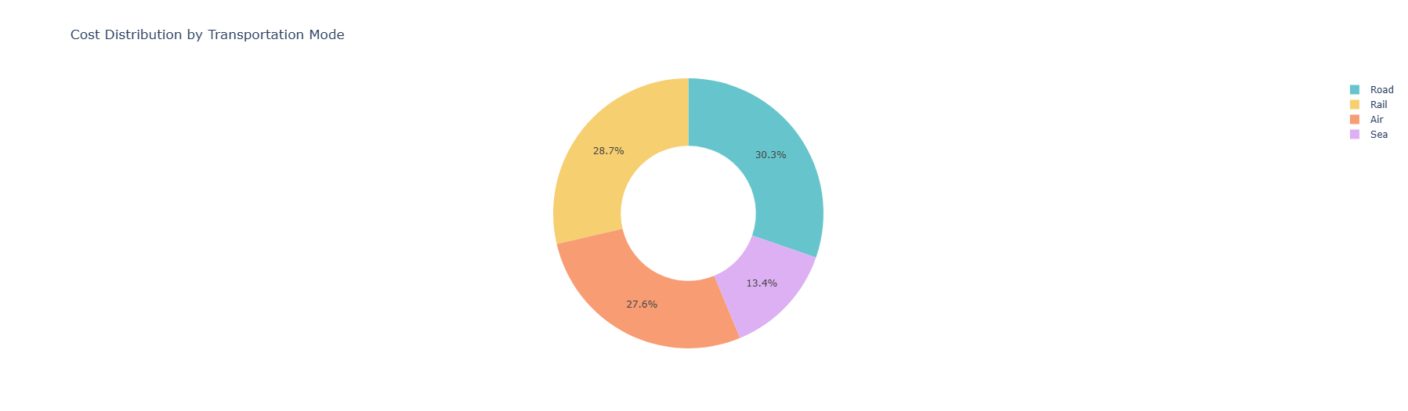
COST DISTRIBUTION BY TRANSPORTATION MODE
In summary, the road transport incurs the highest costs, while the sea route is less expensive. However, we can conclude that road and rail transport are the most effective ways to move products within national borders. Additionally, rail transport is considered the best option for domestic transport.

Slide 10
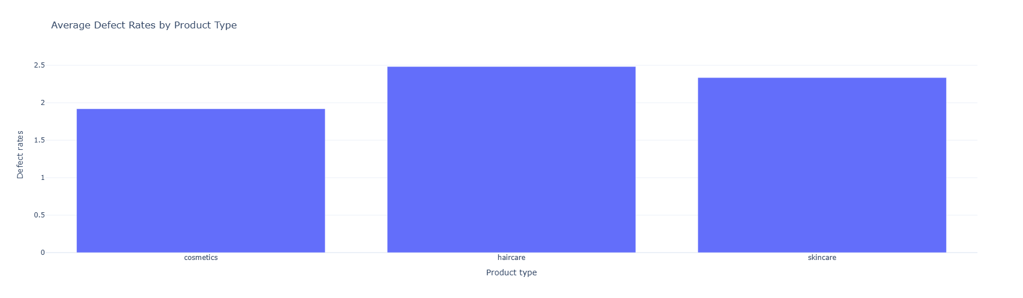
AVERAGE DEFECT RATES BY PRODUCT TYPE
This bar chart shows the average defect rates for three different product types: cosmetics, haircare, and skincare. The skincare category has the highest average defect rate, followed by haircare, and then cosmetics.

Slide 11

Conclusion
After conducting a thorough analysis of the e-commerce supply chain data, we have pinpointed several key objectives that are crucial for the organization's long-term success. These objectives encompass various aspects such as optimizing inventory management, enhancing order fulfilment processes, improving supplier relationships, and leveraging data analytics for better decision-making. By focusing on these areas, we aim to streamline operations, reduce costs, and ultimately enhance customer satisfaction, positioning the organization for sustainable growth in a competitive marketplace

